Slide 1
MINI PROJECT PRESENTATION | COMPUTER SCIENCE AND ENGINEERING
Real-Time Financial Fraud Detection Lakehouse Using Distributed Streaming and Machine Learning
Apache Kafka • PySpark Structured Streaming • Delta Lake • Spark MLlib Random Forest
Bhumika Raut – PRN 23070521221
Arpita Mahakalkar – PRN 23070521020
Symbiosis Institute of Technology, Nagpur
Guide: [Project Guide Name]
Academic Year 2026–27
Notes:
Introduce the team and title. Our project is a complete streaming fraud-detection platform, not just a model in a notebook.

Slide 2
Problem Statement & Motivation
Fraud is judged in seconds, and only makes sense in context
The problem
Why context matters
Why streaming
Fraud is rare, imbalanced and must be detected in seconds. A single transaction means little without customer history.
Same amount: normal for one user, extreme for another. 5 payments in 10 min + new device = suspicious.
Needs event-time windows, per-user state, late/duplicate handling and recovery after failure.
PROBLEM STATEMENT
Build a reliable real-time pipeline that ingests transactions, validates and de-duplicates them, derives behavioural features, scores them with ML + rules, and exposes alerts and monitoring — recoverable after failure.
Real-Time Financial Fraud Detection Lakehouse | SIT Nagpur
2
Notes:
A transaction alone is rarely suspicious. We need the customer history and the last ten minutes of activity, computed while data is still flowing.

Slide 3
Objectives & Scope
▪ Ingest synthetic transactions into Kafka, keyed by user_id
▪ Preserve raw events + Kafka lineage in Bronze Delta
▪ Validate quarantine bad records; 5-min watermark de-duplication
▪ Compute 10-min sliding windows + per-user state (Welford)
▪ Train Random Forest: class weights, temporal split, no label leakage
▪ Decide hybrid ML + rule engine with explainable reasons
▪ Harden checkpoints, idempotent writes, tests, Docker
▪ Monitor benchmark + Streamlit dashboard + Spark History Server
In scope
Synthetic transaction stream, medallion lakehouse, stateful features, RF + rules, dashboard, local Docker deployment.
Out of scope
Real bank data, multi-node cluster scaling, security / PII controls, label delay & drift handling.
Real-Time Financial Fraud Detection Lakehouse | SIT Nagpur
3
Notes:
Eight objectives, all implemented in the repository. Scope: synthetic stream, local Docker deployment.

Slide 4
Existing Approach vs Proposed Solution
TYPICAL LIMITATION
THIS PROJECT
Batch scoring detects fraud late
→
Continuous micro-batch Structured Streaming
Stateless per-transaction model
→
Per-user state via applyInPandasWithState
No recent-velocity context
→
10-min windows, 2-min slide
Duplicates / late events corrupt data
→
Watermark + transaction-ID de-duplication
Bad records lost or crash job
→
Quarantine table with reasons
Label leakage into live scoring
→
Labels kept outside Kafka
Opaque black-box decision
→
Hybrid score + reasons + severity
Restart = duplicates / data loss
→
Checkpoints + idempotent Delta writes
Real-Time Financial Fraud Detection Lakehouse | SIT Nagpur
4
Notes:
Left column: what typical batch/stateless systems do wrong. Right: what we implemented.

Slide 5
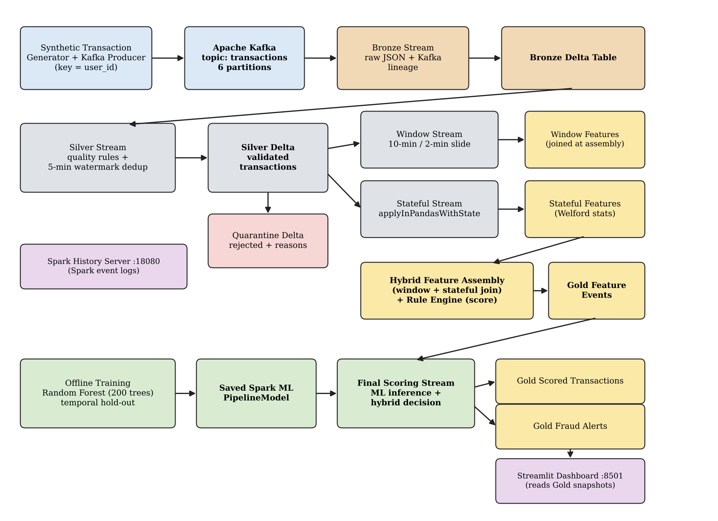
System Architecture
Real-Time Financial Fraud Detection Lakehouse | SIT Nagpur
5
Notes:
Walk left to right, top to bottom: Kafka, Bronze, Silver with quarantine, window and stateful streams, assembly, Gold, ML scoring, dashboard. Six Spark apps, one container each.

Slide 6
End-to-End Transaction Flow
One transaction, seven steps
1 Produce
2 Bronze
3 Silver
4 Features
5 Assemble
6 Score
7 Serve
Event sent to Kafka, key = user_id
Raw JSON + topic, partition, offset
Validate, de-dup; rejects → quarantine
10-min window + user history (read before update)
Join features, rule score, Gold feature event
Random Forest probability + hybrid decision
Scored table, alerts, dashboard
Event contract: transaction_id • user_id • timestamp • amount • merchant_category • device_id. Fraud labels never enter Kafka.
Real-Time Financial Fraud Detection Lakehouse | SIT Nagpur
6
Notes:
Follow a single transaction through these seven stages.

Slide 7
Technology Stack
Apache Kafka
PySpark 3.5.9
Delta Lake 3.3.3
Partitioned, replayable ingestion. Topic "transactions", 6 partitions.
Structured Streaming: event time, windows, watermarks, state.
ACID tables, streaming sinks, idempotent writes.
Spark MLlib
Docker Compose
Streamlit
Random Forest PipelineModel: training + distributed inference.
One container per Spark app; restart policies.
Separate lightweight dashboard on Gold snapshots.
Also: pandas 2.2.3, NumPy 1.26.4, PyArrow 12.0.1, confluent-kafka 2.11.1, pytest 8.3.5
Real-Time Financial Fraud Detection Lakehouse | SIT Nagpur
7
Notes:
Each technology has a clear role. Versions are from requirements.txt and docker-compose.

Slide 8
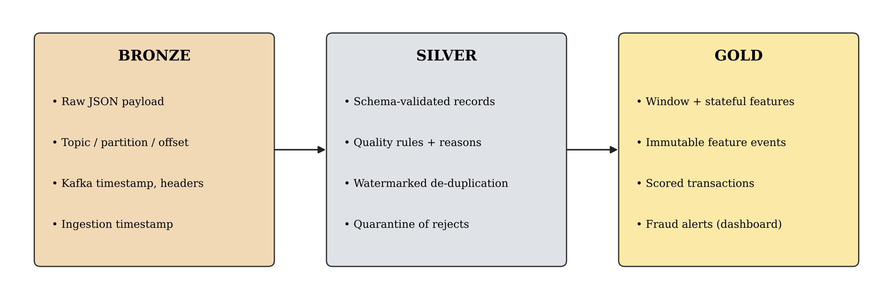
Bronze – Silver – Gold Data Architecture
▪ Quality rules: malformed JSON, missing IDs/timestamp/device/merchant, bad or >1,000,000 amounts, future timestamps → quarantine.
▪ Gold tables: partitioned by event_date; feature events are immutable and append-only.
Real-Time Financial Fraud Detection Lakehouse | SIT Nagpur
8
Notes:
Bronze raw and replayable, Silver clean, Gold serving. All Delta tables.

Slide 9
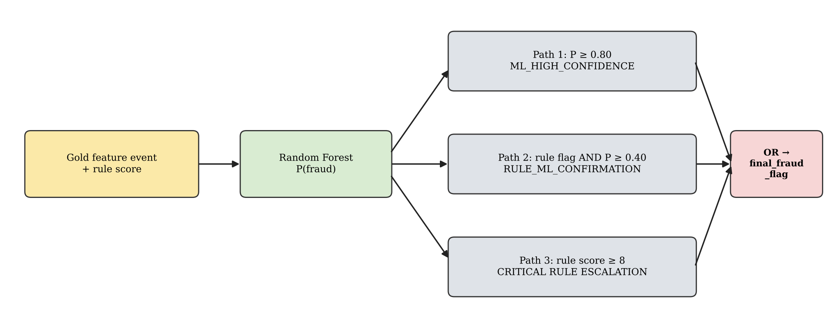
Random Forest & Hybrid Fraud Decision
▪ Model: Spark RF, 200 trees, depth 10, maxBins 64
▪ Pipeline: imputer, merchant index + one-hot, assembler
▪ Imbalance: class-weight column
▪ Validation: temporal split (80% time quantile)
▪ Path 1: P(fraud) ≥ 0.80 → ML_HIGH_CONFIDENCE
▪ Path 2: rule flag AND P ≥ 0.40 → RULE_ML_CONFIRMATION
▪ Path 3: rule score ≥ 8 → critical rule escalation
▪ Output: final flag, severity (LOW–CRITICAL), decision basis, fraud_reasons
Real-Time Financial Fraud Detection Lakehouse | SIT Nagpur
9
Notes:
Metrics describe the Random Forest alone. The hybrid engine adds rules on top. Thresholds are env-configurable.

Slide 10
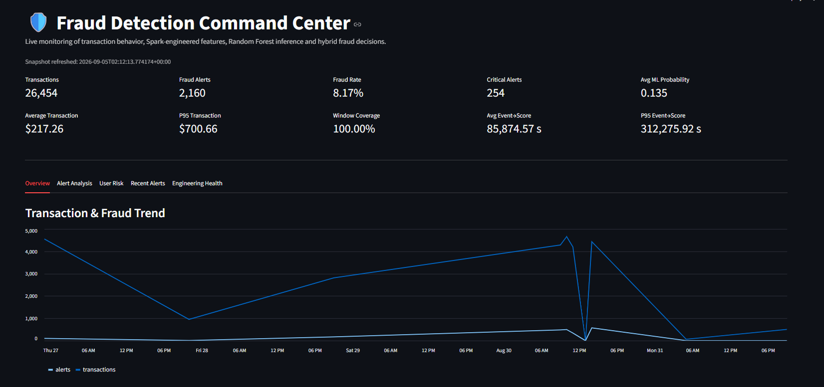
Fraud Command Center – Real Output
Project's own gallery screenshots (snapshot 2026-09-05)
▪ 26,454 transactions processed
▪ 2,160 fraud alerts (8.17%)
▪ 254 critical alerts
▪ 0.135 average ML probability
▪ 100% window-feature coverage
▪ 1,969 unique users
Alert rate ≠ precision: includes rule-confirmed & rule-escalated paths on a replayed run.
Real-Time Financial Fraud Detection Lakehouse | SIT Nagpur
10
Notes:
Dashboard KPIs: 26,454 transactions, 2,160 alerts, 8.17% alert rate, 254 critical. Alert rate is flagged share, NOT precision.

Slide 11
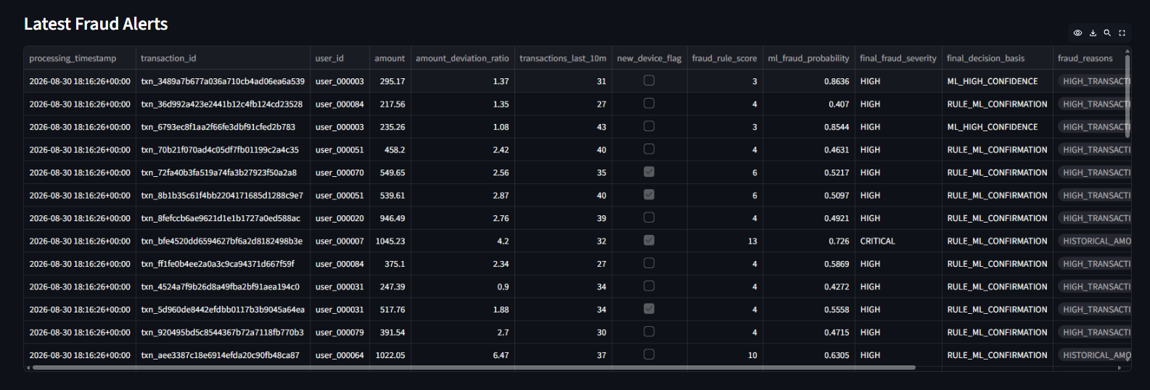
Fraud Alert Investigation View
Each alert shows the evidence behind the decision
▪ Columns: amount, deviation ratio, 10-min count, new-device flag, rule score, ML probability, severity, decision basis, reasons
▪ Decision basis shows which of the three hybrid paths fired
Real-Time Financial Fraud Detection Lakehouse | SIT Nagpur
11
Notes:
Most alerts are RULE_ML_CONFIRMATION (P about 0.41-0.73); a few ML_HIGH_CONFIDENCE (0.85-0.86); one CRITICAL with rule score 13. This shows the three-path hybrid logic on real pipeline output.

Slide 12
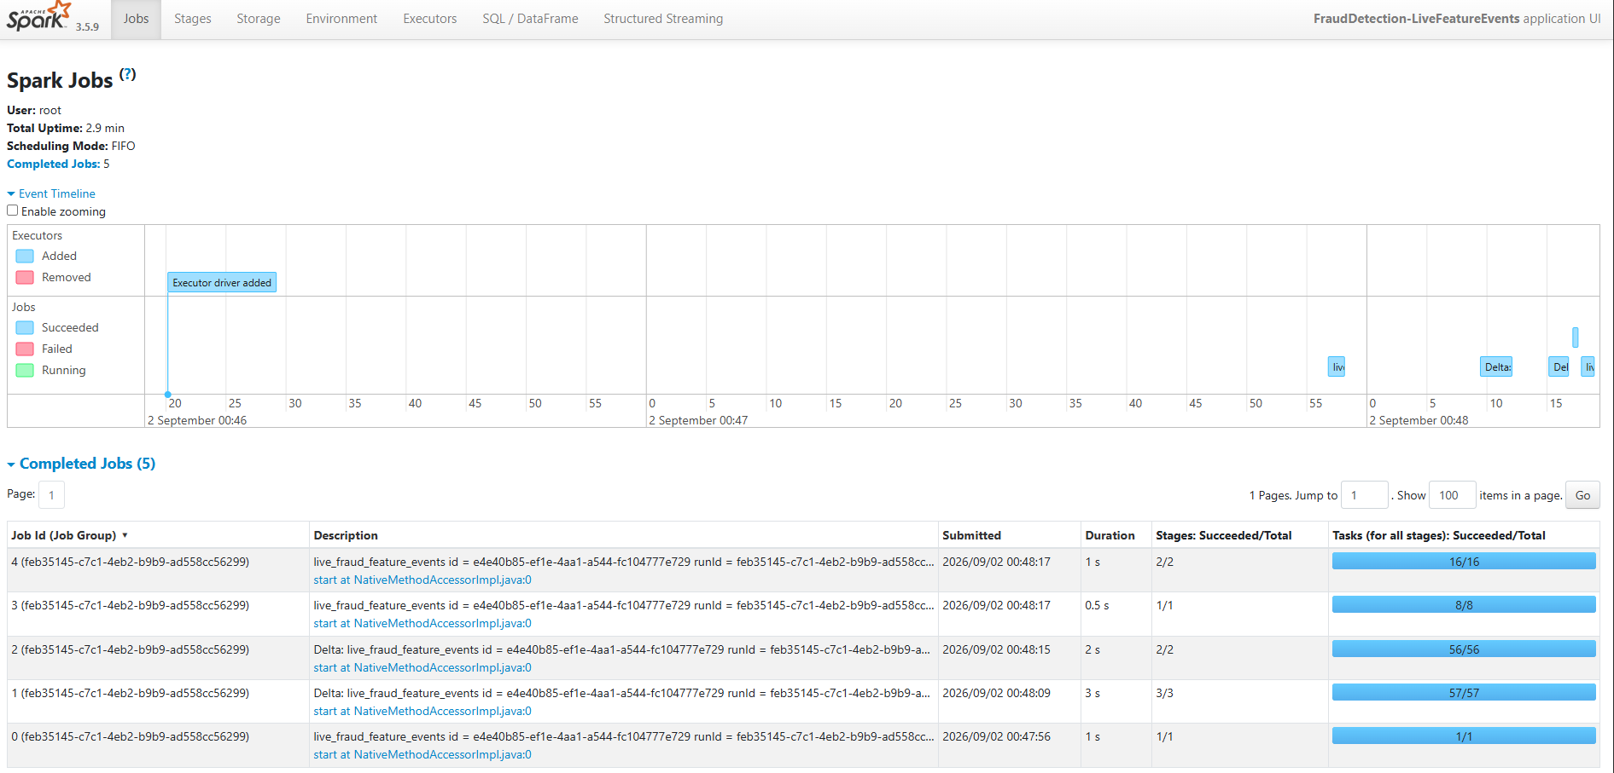
Spark Execution Evidence
Spark History Server – FraudDetection-LiveFeatureEvents
Real-Time Financial Fraud Detection Lakehouse | SIT Nagpur
12
Notes:
Event logs persist, so jobs and stages can be inspected after the run. Short run (2.9 min uptime): evidence of operation, not throughput.

Slide 13
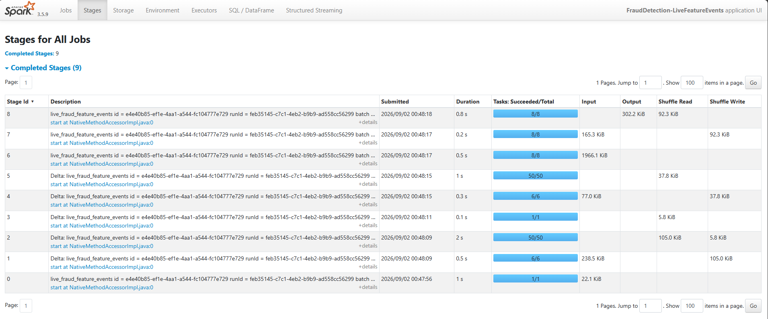
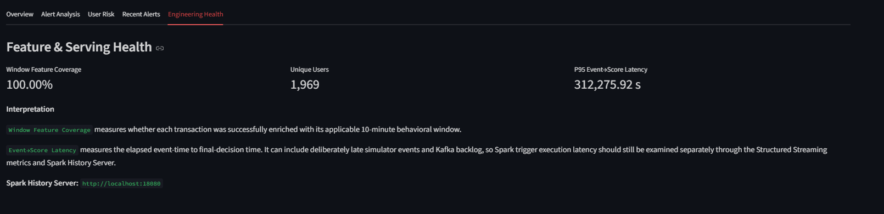
Spark Stages & Engineering Health
Execution detail and serving-health indicators
▪ 5 completed jobs on Spark 3.5.9
▪ StreamingQueryListener logs rows, rate, state memory
▪ 100% window-feature coverage
▪ Event-to-score latency (312,276 s P95) reflects replay backlog, not real-time latency
Real-Time Financial Fraud Detection Lakehouse | SIT Nagpur
13
Notes:
Event-to-score latency includes replayed late events and Kafka backlog; it is not Spark trigger latency (about 0.9-1.7 s per trigger in the benchmark).

Slide 14
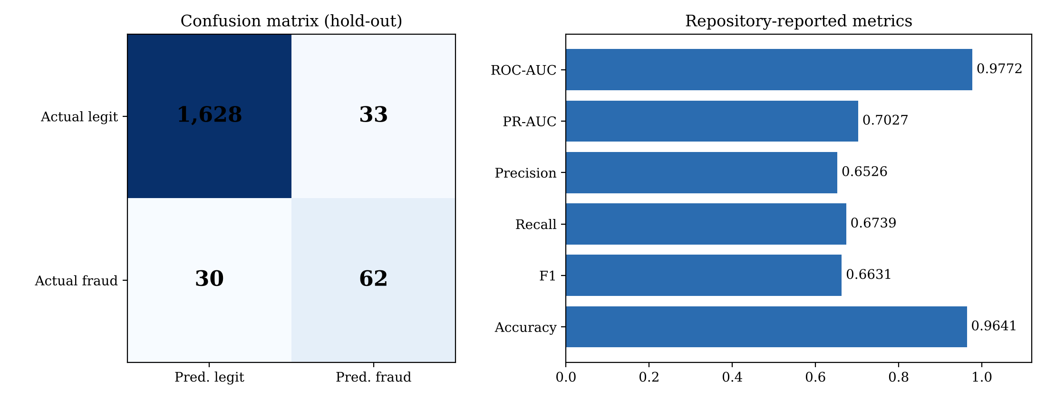
Model Evaluation
▪ ROC-AUC 0.9772
▪ PR-AUC 0.7027
▪ Precision 0.6526
▪ Recall 0.6739
▪ F1 / Accuracy 0.6631 / 0.9641
Why accuracy misleads
Trade-off
Fraud ≈ 5.2% of 1,753 test rows. Predicting "all legit" already gives 94.8% accuracy. Use precision, recall, PR-AUC.
33 false alarms (analyst cost) vs 30 missed frauds (loss). Threshold shifts one into the other. Offline, repository-reported, synthetic data.
Real-Time Financial Fraud Detection Lakehouse | SIT Nagpur
14
Notes:
Repository-reported results on temporal hold-out; consistency checked: 62+33+30+1628=1753. All-legit baseline gets 94.8% accuracy so accuracy alone is misleading.

Slide 15
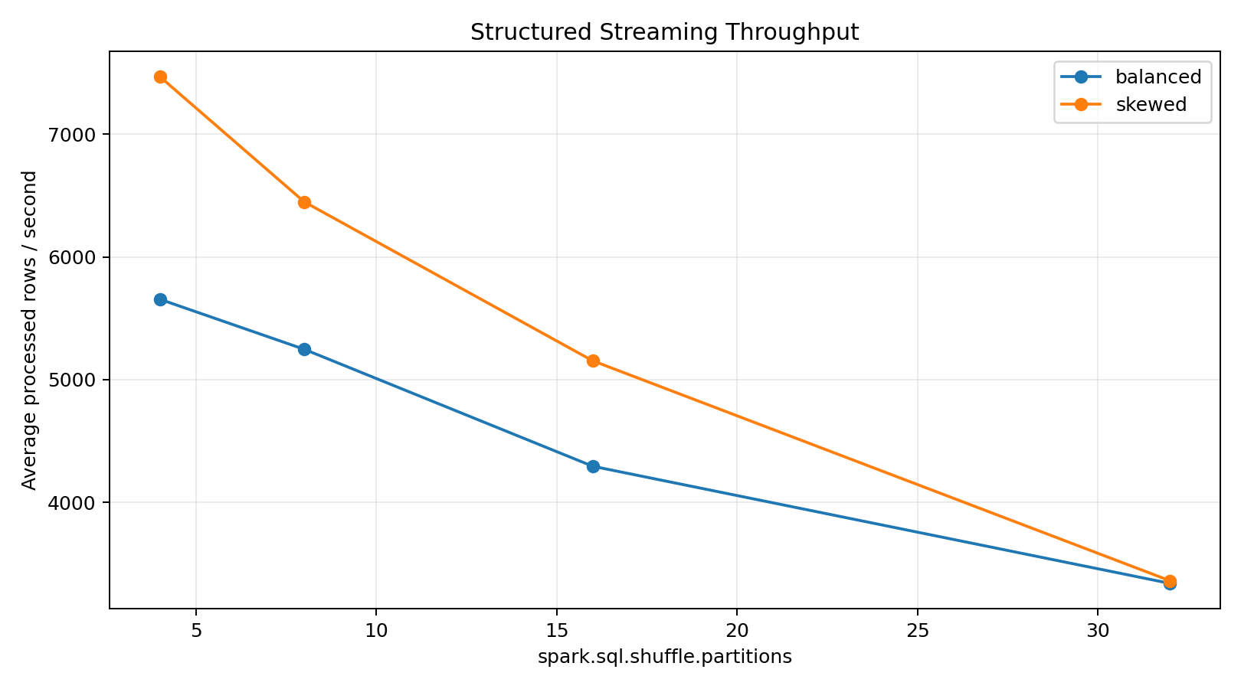
Performance Benchmark – Shuffle Partitions
4 / 8 / 16 / 32 partitions; balanced vs 90% hot-key traffic
Workload | Parts | Rows/s | P95 ms | State MB
balanced | 4 | 5,655 | 1,066 | 10.36
balanced | 8 | 5,248 | 1,150 | 10.14
balanced | 16 | 4,295 | 1,315 | 10.74
balanced | 32 | 3,340 | 1,637 | 13.14
skewed | 4 | 7,469 | 893 | 1.09
skewed | 8 | 6,450 | 829 | 1.14
skewed | 16 | 5,154 | 1,092 | 1.20
skewed | 32 | 3,362 | 1,723 | 1.34
▪ Selected 4 partitions; all configs met the 5 s trigger budget. user_id is NOT salted – salting would split one customer's history.
▪ Local single-machine Docker result, not a cluster benchmark.
Real-Time Financial Fraud Detection Lakehouse | SIT Nagpur
15
Notes:
Chosen: 4 partitions (baseline 8). Balanced: +7.76% throughput, +7.30% P95 improvement. Skewed: +15.80% throughput but P95 7.72% worse. Local Docker only.

Slide 16
Reliability, Testing & Deployment
Checkpoints
Idempotent writes
Offsets, committed batches and state-store data per query
Delta txnAppId + txnVersion (batch ID) – retries do not double-commit
Quarantine
Docker
Invalid records kept with reasons, never silently dropped
One service per Spark app, restart: unless-stopped
TESTS IN REPOSITORY (7 test functions, 5 files)
▪ Unit: Welford statistics, transaction-quality rules, final fraud decision
▪ Integration: checkpoint recovery (stop → add data → restart), Delta idempotency
Real-Time Financial Fraud Detection Lakehouse | SIT Nagpur
16
Notes:
Seven test functions in five files counted from source. We have not re-run them for this deck.

Slide 17
Limitations & Future Scope
LIMITATIONS
FUTURE SCOPE
▪ Synthetic data – not proof of real-world accuracy
▪ Offline hold-out of 1,753 rows (92 frauds)
▪ Metrics cover the RF, not the full hybrid engine
▪ Single local Docker benchmark
▪ Uncalibrated probabilities, heuristic thresholds
▪ No label delay / concept drift handling
▪ No security / PII controls
▪ Test on a public real fraud dataset
▪ Probability calibration, cost-based thresholds
▪ Drift monitoring and scheduled retraining
▪ Graph and merchant-level features; compare with GBTs
▪ Multi-node cluster benchmark
▪ Authentication, encryption, alert routing
Real-Time Financial Fraud Detection Lakehouse | SIT Nagpur
17
Notes:
Be honest: synthetic data, offline metrics, local benchmark.

Slide 18
Conclusion & Key Contributions
▪ Complete Kafka → Bronze/Silver/Gold Delta → stateful features → RF + rules → dashboard
▪ Leakage-safe labels outside Kafka; temporal split; state read before update
▪ Reliable checkpoints, idempotent writes, quarantine, tests
▪ Measured ROC-AUC 0.9772, PR-AUC 0.7027; 4-partition choice from benchmark
Thank you
Questions?
KEY REFERENCES
Kreps et al., Kafka (NetDB 2011) • Zaharia et al., Apache Spark (CACM 2016) • Armbrust et al., Structured Streaming (SIGMOD 2018) • Armbrust et al., Delta Lake (VLDB 2020)
Breiman, Random Forests (2001) • Welford (1962) • Dal Pozzolo et al., TNNLS 2018 • Saito & Rehmsmeier, PLOS ONE 2015
Repo: github.com/Imperator8000/real-time-fraud-detection
Real-Time Financial Fraud Detection Lakehouse | SIT Nagpur
18
Notes:
Close, then take questions. References on the slide.

